Slide 1

SILICON VALLEY
INSPIRING women to EXCEL in technology careers
and PIONEER new industries
Guiti Nabavi, Snehal Patil, SV Director
www.womenwhocode.com/sv
Tax ID: 46-4218859

Slide 2
WWCODE Silicon Valley
Thank YOU for extraordinary Achievement !
Established May 13, 2014
Produced over 245 Events, Seminars, Workshops
Increased membership from 2 to 3118 members
Added X Hack Club for groups of coders creating MVP using X technology (python, iOS, ROR…)
Added Venture Hack Club for entrepreneurial members
Added Career Hack Club to help women coders career
Hack for Safe Campus

Slide 3
WWCODE Silicon Valley
2017 Strategic Plan

Slide 4
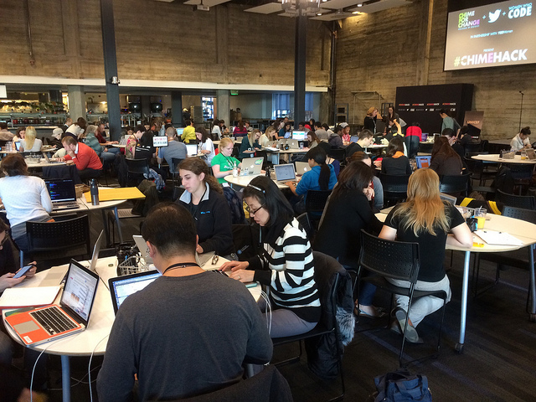

Corporate MISSION
WWCode is a global nonprofit dedicated to inspiring women to excel in technology careers.
“We connect amazing women with like-minded women leaders around the globe who unite under one simple notion – the world of technology is much better with women in it.”
-Alaina Percival, WWCode CEO

Slide 5
WWCode-sv MISSION
There are industries that women are not participating as much as they should and some of these industries are the leaders of the future. As women technologists, we need to understand and anticipate the technology needs of these industries.
“When you are a pioneer you have a seat at the table, at the head of the table, actually you have made the table!”
-Guiti Nabavi, WWCode-sv, Director

Slide 6
WWCODE Silicon Valley
WWCODE MISSION
WWCode is a global nonprofit dedicated to inspiring women to excel in technology careers.
WWCODE-Silicon Valley MISSION
WWCode-SV is the Silicon Valley Chapter of WWCode and is dedicated to inspiring women to excel in technology careers and pioneer new industries.

Slide 7
INDUSTRY NEEDS
1.4M software engineering jobs will be available in 2020
1M jobs are expected to go unfilled by traditional avenues.
Women hold 51% of all professional occupations
Note: Women could have the early adopter advantage to new industries (WWCode-sv)

Slide 8
Industry focus
The study, “The Digital Dividend-First Mover Advantage," was published by Harvard Business Review Analytic Services and sponsored by Verizon Enterprise Solutions.
“Big Five” technologies—mobile, social, cloud computing, advanced analytics and machine-to-machine communications
Connected and Autonomous Cars
IOT

Slide 9
2017 strategic plans
Increase the membership by 50%
Increase the quality of events and quantity of attendance by 25% each
Provide more training, better networking and more career events. Increase events by 10% and survey satisfaction by 10% each quarter
Increase 2017 budget to $10,000

Slide 10
2017 tactical plans
Monthly tech talks
  Data Science, iOS,
Quarterly Hack club or Workshops
  Machine Learning
  Interview Prep
Quarterly Venture Hack Club
Quarterly Career Hack Club
  Mini job fairs
  Agile training
Industry focus event
  Smart City, TBD
Hackathon

Slide 11
2017 tactical plans
Leaders to remain in Active standing
  Remove inactive leader access
  Attendance in Quarterly meeting
  Measurement of Key metrics (attendance, satisfaction)
Research processes to increase attendance
  Charging for events, provide coupons for next event that will only be given to those who attend?
Infrastructure
  Google Docs will be moved

Slide 12
2017 Risk Analysis
Needs:
Resources
  Need Project Manager
  Need Evangelist help
  Process professionals
Risks
  Lack of focus
  Lack of effective PM
  Lack of defined processes & roles
Budget
  We will charge for Hackathon
  We will charge for IOT and/or Smart City event

Slide 13
THANK YOU

